Slide 1




ECOPRENEUR HACKATHON
Title: RePouch – A Smart & Sustainable Packaging Solution
Subtitle: Bioplastics + Refill System + AI = Cleaner Earth
Presented by: The Avalanche
Team Members: Riya Saraf, Shreya Saraf, Sonam Nimje, Sameeksha Vishwakarma

Slide 2

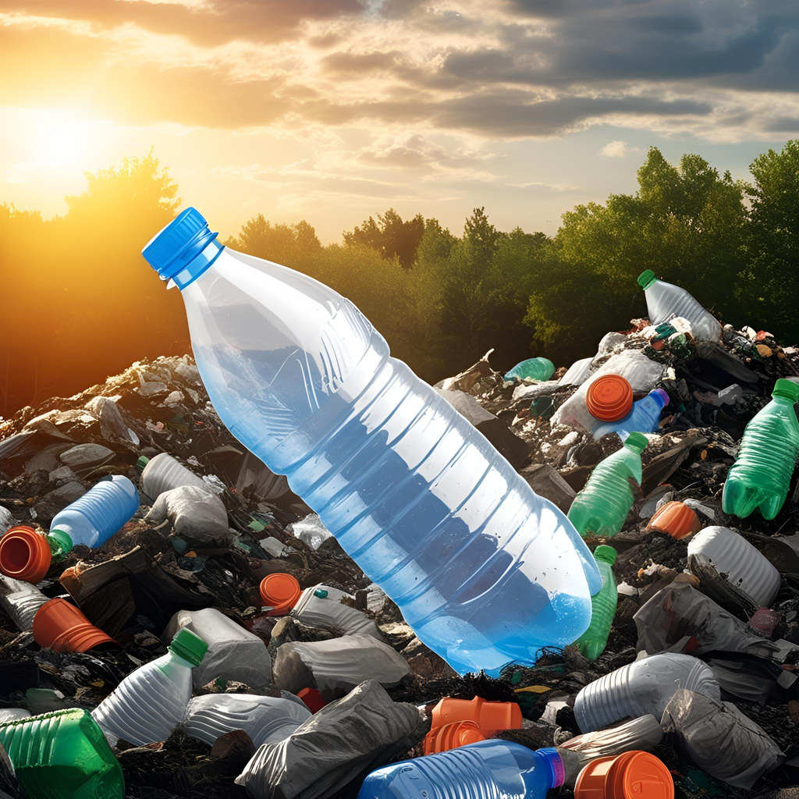

PLASTIC IS EVERYWHERE — AND THAT’S A PROBLEM
FMCG products = largest source of single-use plastic
Most plastic ends up in landfills or oceans
Customers want eco-friendly options, but don’t want to compromise on convenience or price
FMCG companies want to go green but worry about cost, logistics, and customer satisfaction

Slide 3

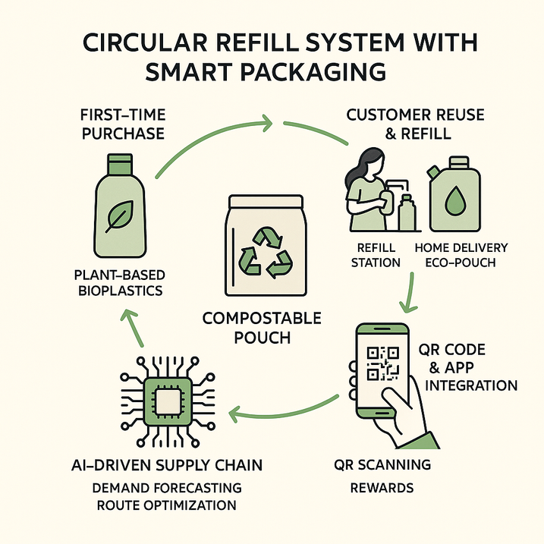
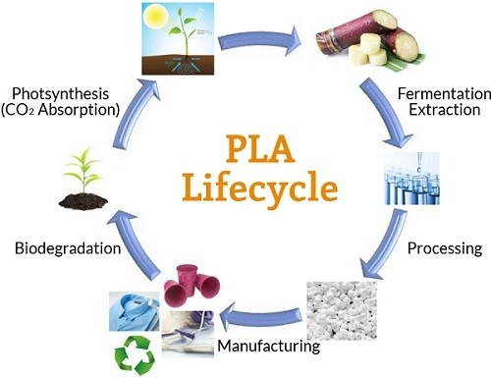
OUR HYBRID SOLUTION – REPOUCH
PLA bioplastic packaging for first purchase (fully compostable)
Refill packs in home-compostable pouches for repeat buys
AI engine to manage delivery, reminders & eco-points
Supports local return stations, compost collection and rewards

Slide 4

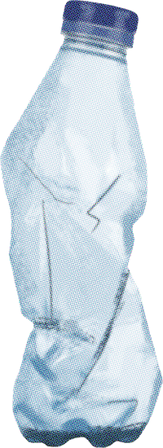



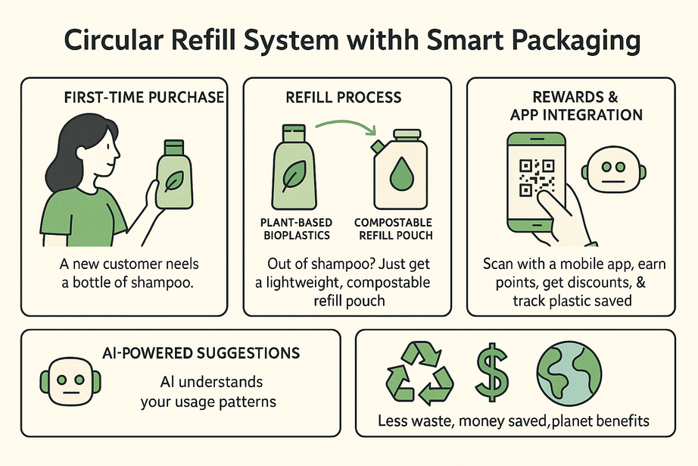

How the RePouch System Works?
First Time: User gets product in PLA container
Next Time: Refill in compostable pouch(less plastic, same product)
Options:
Dispose in home compost OR
Return to store/delivery boy
Refilled product is delivered in less cost & packaging

Slide 5



ROLE OF AI
Smart Packaging Needs Smart Tech
Sends reminders via SMS or app
Awards eco points on refills, which can be redeemed for discounts
AI predicts customer refill cycles (e.g., shampoo every 30 days)
Tracks returns, avoids misuse

Slide 6
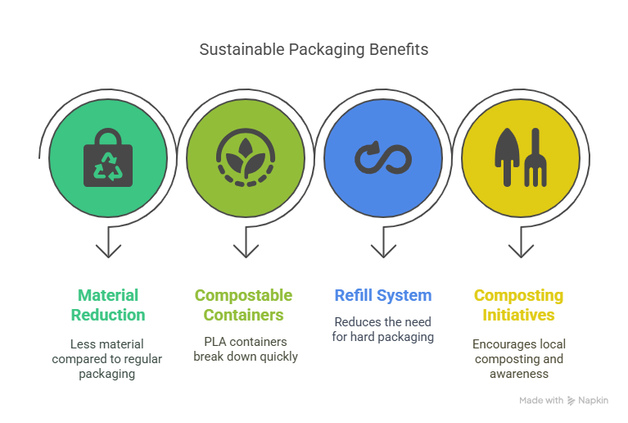
ENVIRONMENTAL IMPACT
Reduce, Reuse, RePouch!
Up to 70% less material used vs regular packaging
PLA containers compost in 3–6 months
Refill system reduces need for repeated hard packaging
Encourages local composting initiatives and awareness

Slide 7
BUSINESS VIABILITY
Sustainability That Makes Business Sense
Factor | RePouch Model Advantage
Cost | High only in 1st purchase, cheap refills afterwards
Customer Loyalty | Points & app rewards build long-term relationships
Branding | Green image boosts trust, attracts eco-conscious users
Operations | Existing supply chain with small tweaks required

Slide 8
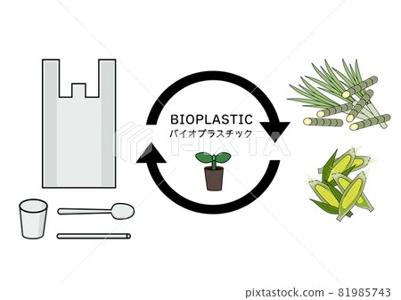

REAL-WORLD USE CASES
WHERE REPOUCH CAN WORK?
Shampoos, oils, handwashes (liquids)
Masalas, grains, tea/coffee (dry goods)
Cosmetics: Creams, facewash jars
Cleaning: Floor cleaners, detergents

Slide 9

FUTURE SCOPE
Growing Greener Together
Launch mobile app for refill orders, tracking & rewards
Refill kiosks at local kirana stores
Collaborate with local composters & NGOs
Launch child education campaigns on plastic use
Offer QR code scan games to educate & reward users

Slide 10


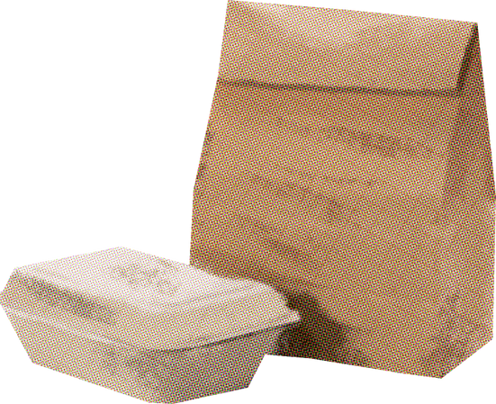
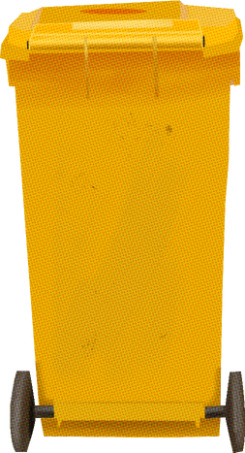
THANK YOU
Let’s Reuse. Refill. RePouch.
Thanks for your time!
We believe that small changes in packaging = big changes for Earth

